Slide 1

Flipkart Mobile Market Analysis

Slide 2
About Me
NAME : SIVANI CHALLA
Background : B.Tech in Computer Science and Engineering
Why I want to learn Data Science? : I want to learn Data Science to build strong analytical skills, work with real-world data, and solve business problems using data-driven Insights and machine learning.
Experience : Fresher
LinkedIn : https://www.linkedin.com/in/challa-sivani-487803372
GitHub: https://github.com/sivanichalla12/Filpkart-Mobile-Market-Analysis-using-Web-Scraping.git

Slide 3
Table of contents
Project Overview
Project Workflow
Business scenario
Business Objective
Data Collection
Dataset Overview
Data Dictionary
Data Cleaning & Preprocessing
Analysis of the Objectives (EDA)
Overall Key Findings
Business Recommendations
Conclusion
Q & A

Slide 4
Project Overview
Collected smartphone data from the Flipkart website using Python Web Scraping.
Extracted product information including Brand, Model, Price, RAM, ROM, Display, Battery, and Color.
Cleaned and preprocessed the scraped data by handling missing values, duplicates, and data type conversions.
Performed Exploratory Data Analysis (EDA) to understand smartphone market trends and product specifications.
Created visualizations to analyze brand distribution, price trends, RAM, ROM, battery capacity, and other key features.
Exported the cleaned dataset for future analysis and reporting.

Slide 5
Project Workflow
1
2
3
4
Website selection
Web scraping
Data understanding
Data cleaning
Choose the Flipkart mobile website
Extract 720 packages from 30 destination pages
Review structure, data types and missing values
Validate values and engineer derived features
5
6
7
8
Exploratory analysis
Visualization
Insights
Final report
Examine price, duration, type and region
Build charts and interactive dashboards
Derive findings and recommendations
Compile the deck, dataset and notebook

Slide 6
Business Scenario
Flipkart offers thousands of smartphones with different brands, prices, and specifications.
Customers often find it difficult to compare products and identify the best option based on their requirements.
Businesses need to understand market trends, pricing strategies, and popular product configurations to stay competitive.
By collecting and analyzing smartphone data from Flipkart, businesses can identify customer preferences and market demand.
The insights generated from this analysis can support pricing decisions, inventory planning, product recommendations, and marketing strategies.

Slide 7
Business Objective
Analyze smartphone data available on Flipkart using web scraping techniques.
Understand pricing patterns across different smartphone brands and models.
Identify popular smartphone specifications such as RAM, ROM, Battery.
Compare products based on features and price to understand market trends.
Generate data-driven insights to support pricing strategies, inventory planning, and product recommendations.
Help customers and businesses make informed decisions using analytical insights.

Slide 8
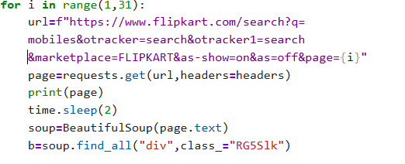
Data Collection: Web Scraping Script
Source
Scraped data from 30 result pages containing smartphone products.
Method
Used Python Requests to send HTTP requests.
Parsed HTML pages using BeautifulSoup.
Fields Extracted
Brand, Model, Price, RAM, ROM, Display, Battery Capacity, Color.
Parsed Fields
Parsed product specifications into structured data using Regex.
Responsible Crawling
Implemented a User-Agent and request delay to ensure responsible web scraping.

Slide 9
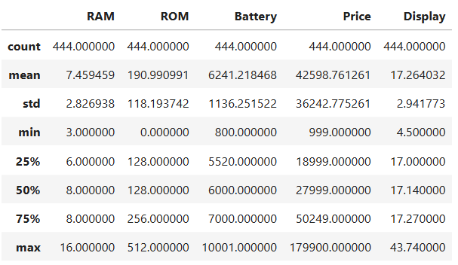
Dataset Overview
The dataset contains 444 smartphone listings, with each row representing one mobile phone available on Flipkart.
The final cleaned dataset consists of 8 features, including Brand, Model, RAM, ROM, Battery, Price, Display, and Color.
The data was collected by scraping 30 Flipkart search result pages using Python.
Missing values were handled, duplicate records were removed, and data types were converted during preprocessing.
The cleaned dataset is exported as a CSV file for further analysis and visualization.

Slide 10
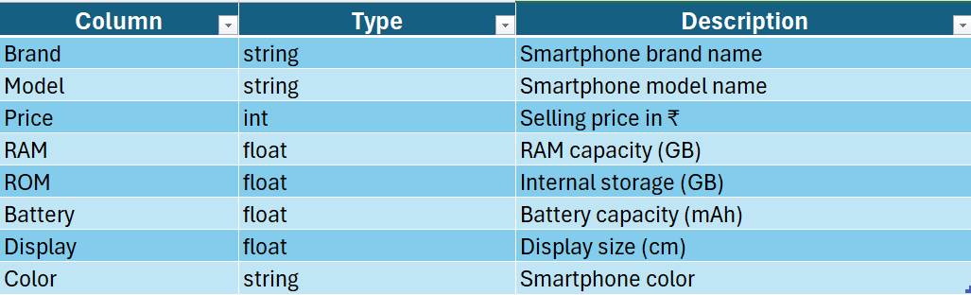

Data Dictionary
Scraped Fields Parsed and Derived Fields

Slide 11
Data Cleaning & Preprocessing
Missing values were identified and handled using appropriate imputation techniques.
Duplicate records were checked and removed to improve data quality.
Numerical columns were converted to appropriate data types for analysis.
Categorical columns were cleaned by handling blank values and standardizing text.
Three derived features (Price_Category, RAM_Category, Battery_Category) were created for better segmentation.
The cleaned dataset was validated and exported as Flipkart_Mobile_Cleaned.csv for further analysis.

Slide 12
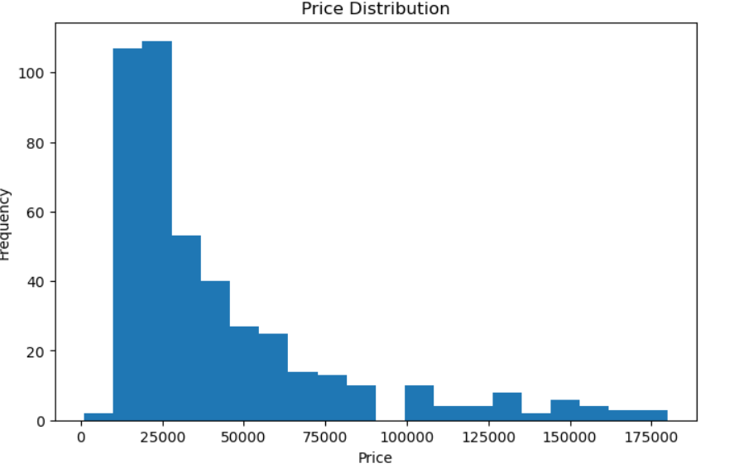
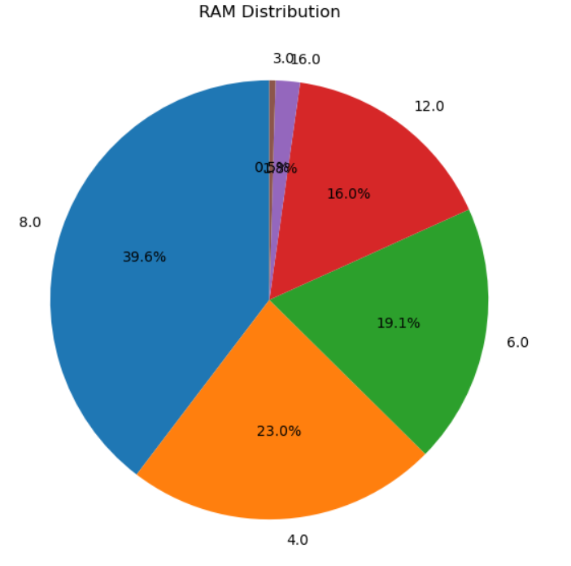
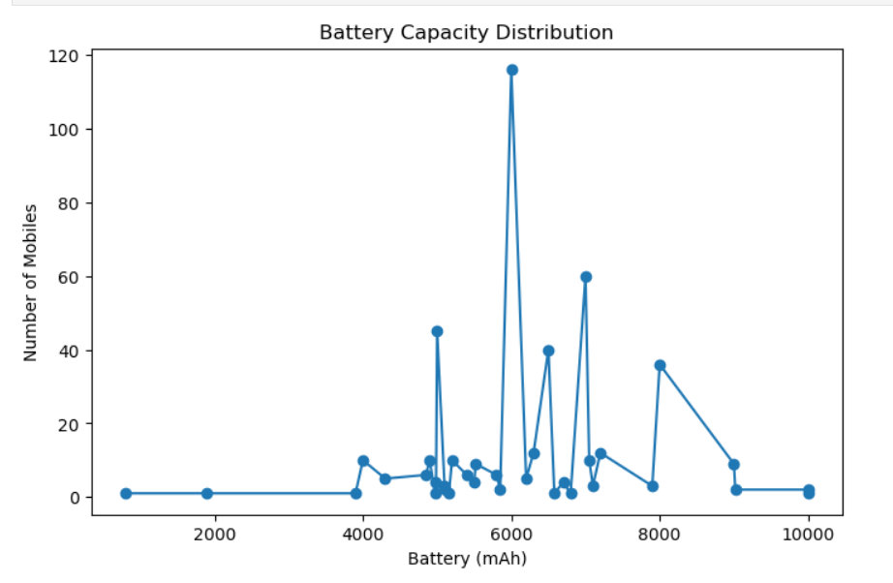
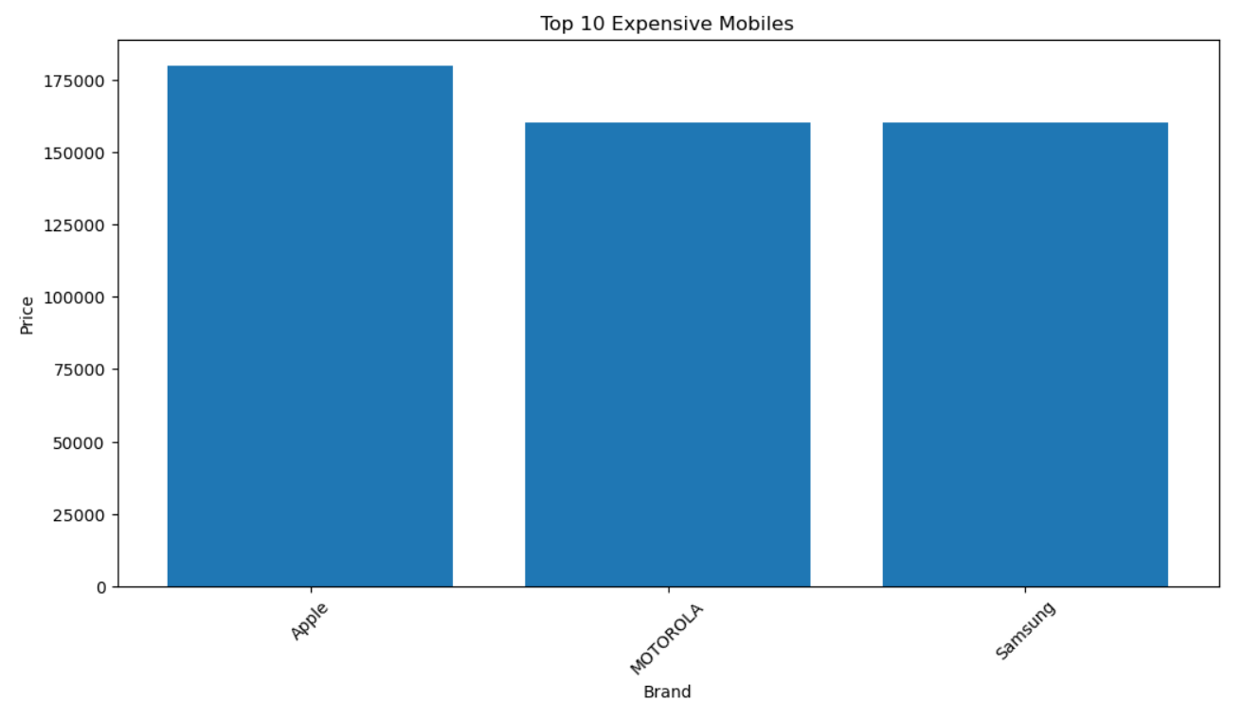
EDA: Price & Smartphone Feature Distributions
Key Observations :
Price: Most smartphones are available in the budget and mid-range segments.
RAM: 6 GB and 8 GB RAM models dominate the dataset.
Battery: 5000 mAh is the most common battery capacity.
Brand: Samsung has the highest number of smartphone listings.

Slide 13
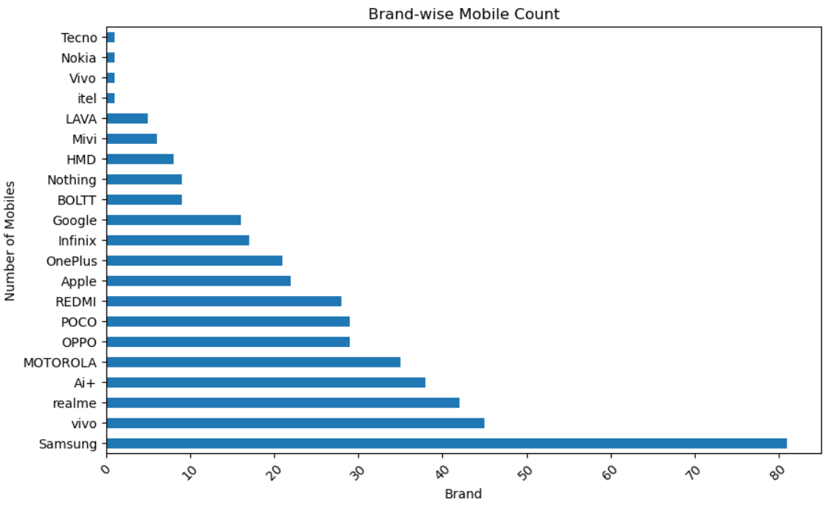
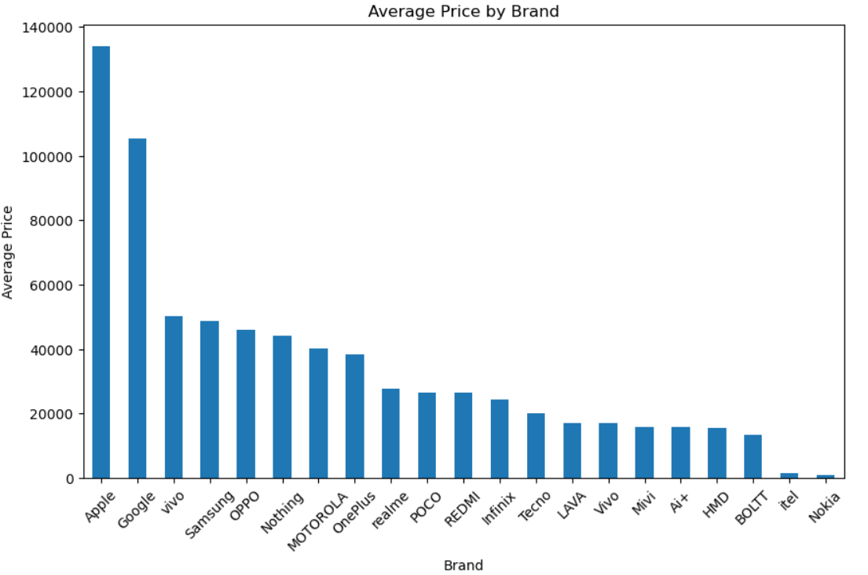
EDA: Brand & Price Analysis
The analysis shows that the top brands contribute the highest number of smartphone listings, while premium brands have comparatively higher average prices than budget-oriented brands.

Slide 14
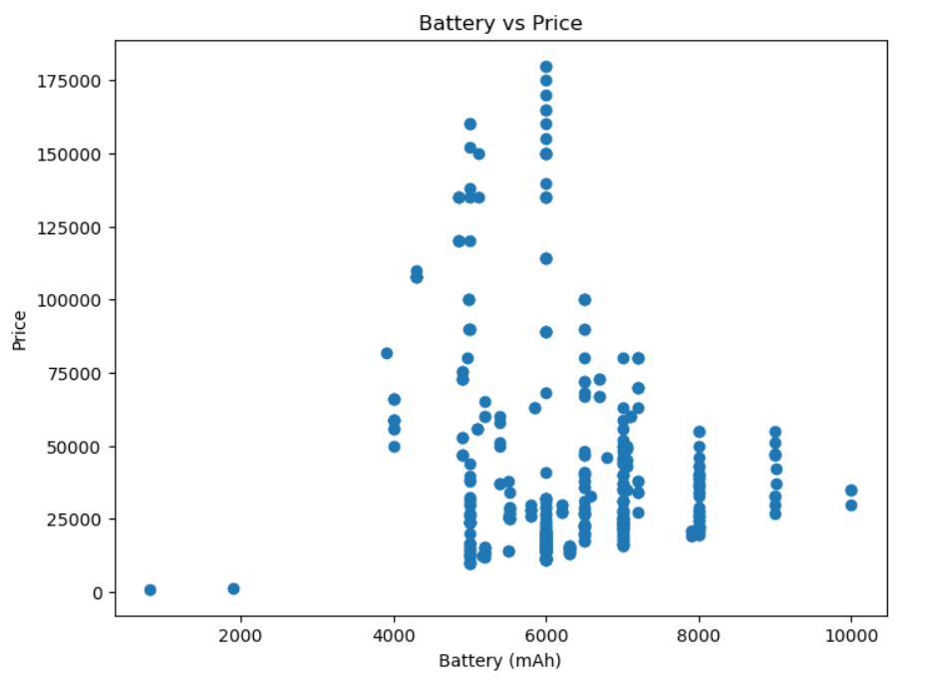
EDA: Price vs Battery Capacity
Price vs Battery Capacity :
Higher battery capacity is generally associated with higher smartphone prices.
Most smartphones are concentrated around the 5000 mAh battery segment.
Premium smartphones appear as high-price outliers regardless of battery capacity.
Battery capacity alone does not determine the selling price, as other features also influence pricing.

Slide 15
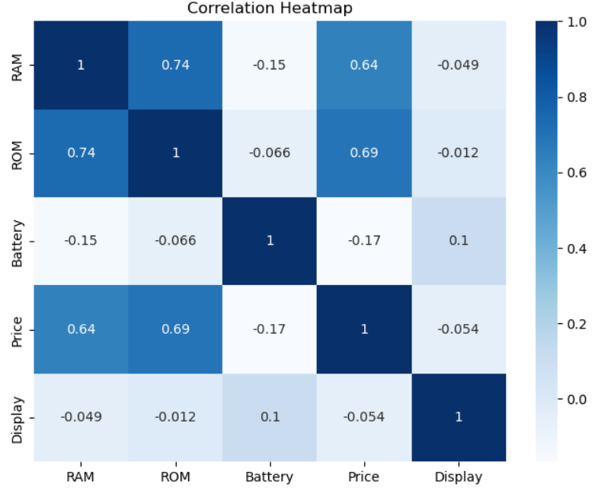
Multivariate Analysis
Key Observations :
Premium brands generally offer smartphones with higher RAM and higher prices.
Smartphones with larger RAM and battery capacity tend to have higher selling prices.
Budget brands are concentrated in the lower price segments with standard specifications.
Multiple features such as RAM, Battery, Display, and Brand collectively influence smartphone pricing.

Slide 16
Overall Key Findings
A total of 444 smartphone listings were successfully scraped and analyzed from Flipkart.
Samsung has the highest number of smartphone listings, indicating a strong market presence.
Most smartphones fall within the budget and mid-range price segments, making them the most competitive categories.
Smartphone prices generally increase with better specifications such as higher RAM, larger storage, and bigger battery capacity.
Data cleaning and preprocessing improved the dataset quality by handling missing values and ensuring consistency.
Exploratory Data Analysis (EDA) revealed valuable insights into pricing trends, brand distribution, and smartphone specifications, supporting data-driven decision-making.

Slide 17
Business Recommendations
Focus on expanding the Budget and Mid-Range smartphone portfolio, as these segments have the highest market presence.
Maintain a strong inventory of 6 GB/8 GB RAM and 5000 mAh battery models to match customer demand.
Strengthen marketing efforts for high-performing brands while promoting emerging brands through targeted offers.
Use pricing and specification insights to develop competitive pricing strategies and improve customer engagement.
Continuously monitor market trends through web scraping and data analysis to support data-driven business decisions.

Slide 18
Conclusion
This project successfully demonstrated the end-to-end process of collecting smartphone data from Flipkart using Python-based web scraping, followed by data cleaning, preprocessing, and exploratory data analysis. The analysis provided valuable insights into smartphone pricing, brand distribution, RAM, battery capacity, and other key specifications, helping identify market trends and customer preferences. Overall, the project highlights the practical application of Python, Web Scraping, Pandas, NumPy, and Data Visualization techniques to transform raw data into meaningful business insights for informed decision-making.

Slide 19

THANK YOU

